Slide 1
MCA Final Year Project (Review III)
E-SAHAKARA (Initialization and configuration, General Ledger & Financial Statements)
Submitted to the Presidency University, Bengaluru in partial fulfillment for the award of the degree of Master of Computer Applications(MCA)
Project Number : MCA_PR218
Ass
Under the supervision of
Mr. S. Shakthi
Asst. Prof of SCSE
Presidency University, Bengaluru
Name | Roll Number
Shubhan G C | 20232MCA0194

Slide 2
Content
Problem Statement
Screenshot
Github link

Slide 3
Problem Statement
Lack of Standardized Setup - Cooperative societies struggle with inconsistent system configurations, leading to operational inefficiencies and compliance issues.
Data Validation Issues – The absence of automated validation mechanisms results in inaccurate member and financial records, impacting decision-making
Inaccurate Financial Tracking – Manual bookkeeping leads to errors in transaction records, affecting financial integrity and decision-making.
Audit and Reporting Challenges – The absence of structured audit trails makes financial verification and reporting cumbersome, increasing the risk of discrepancies.

Slide 4

Screenshots
Login Page

Slide 5
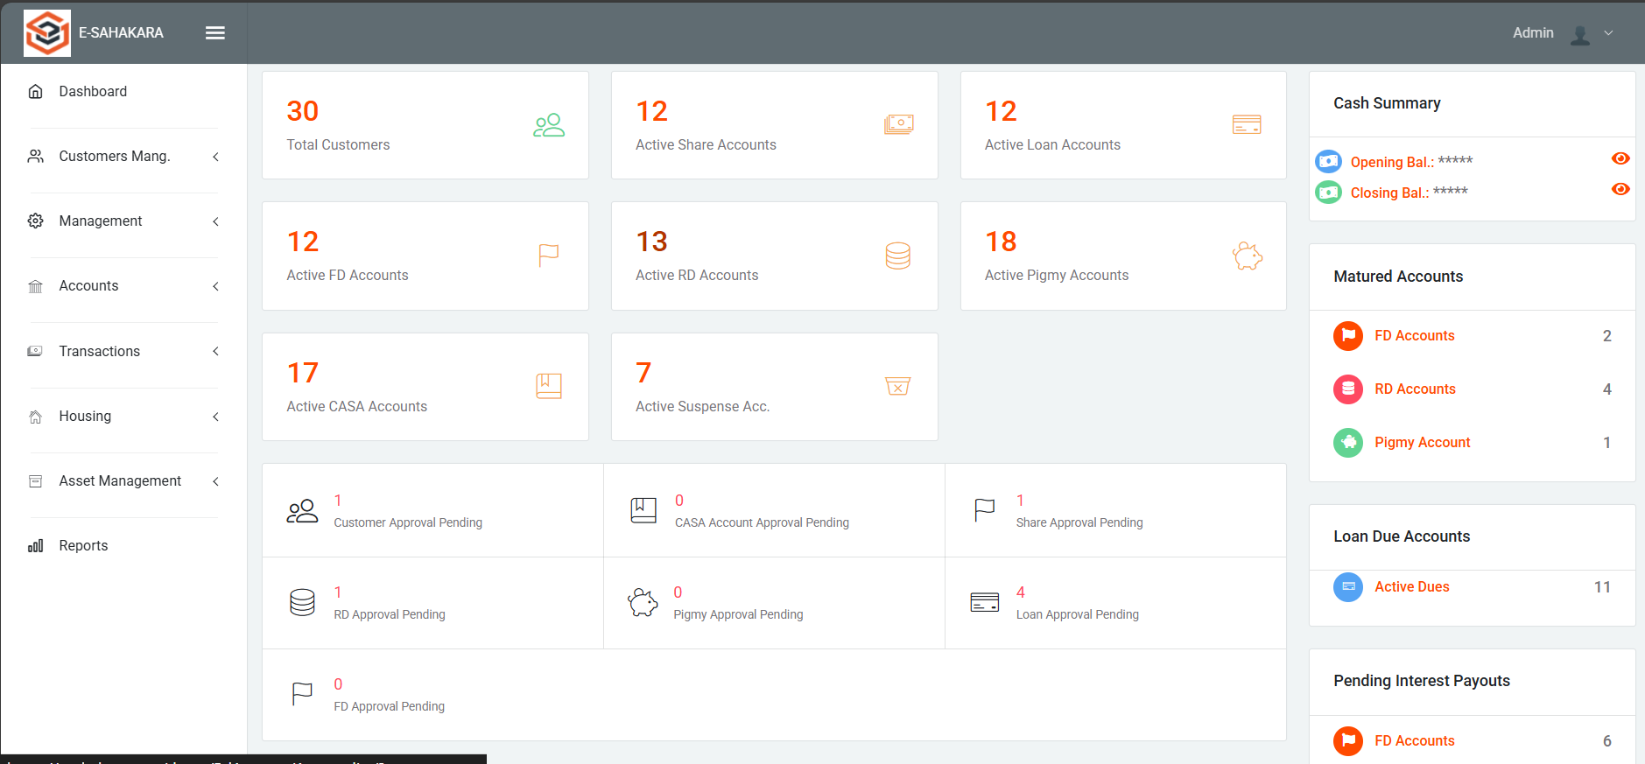
Dashboard

Slide 6
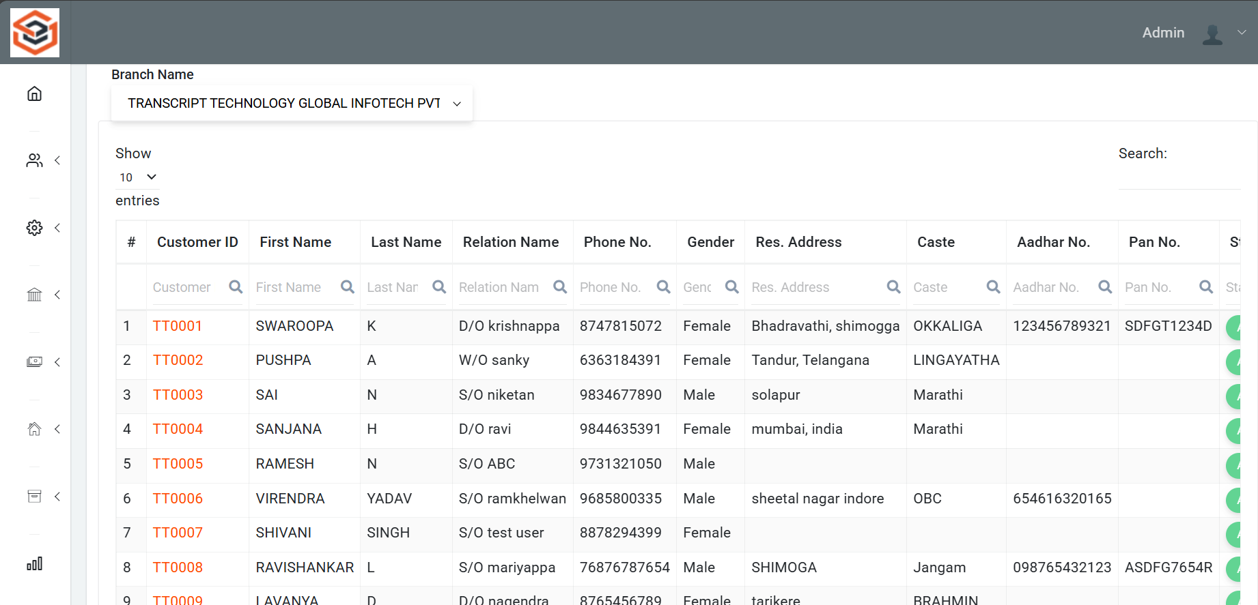
Customer list

Slide 7
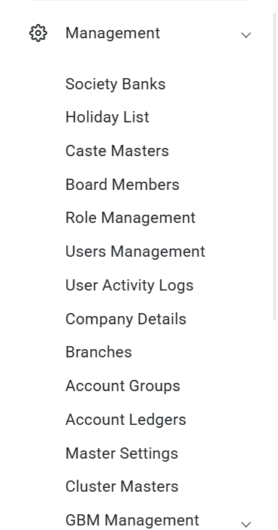
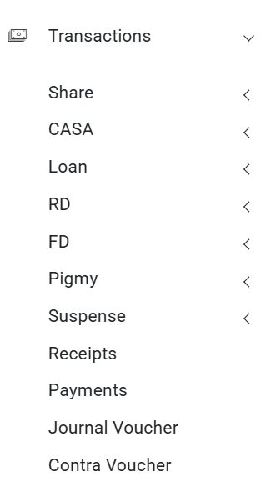
Management & Transactions

Slide 8
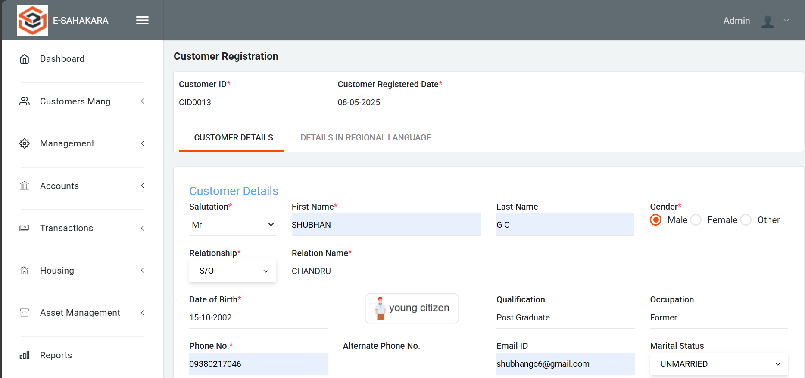
Customer Registration Form

Slide 9
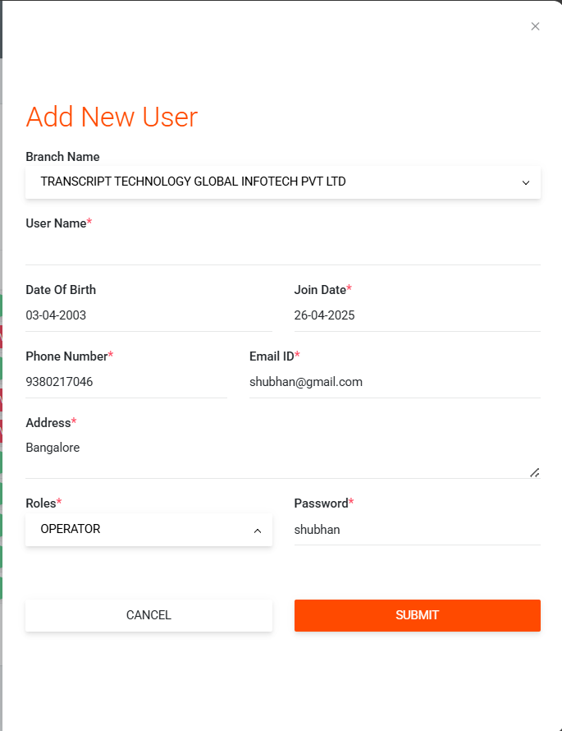
Add New User

Slide 10
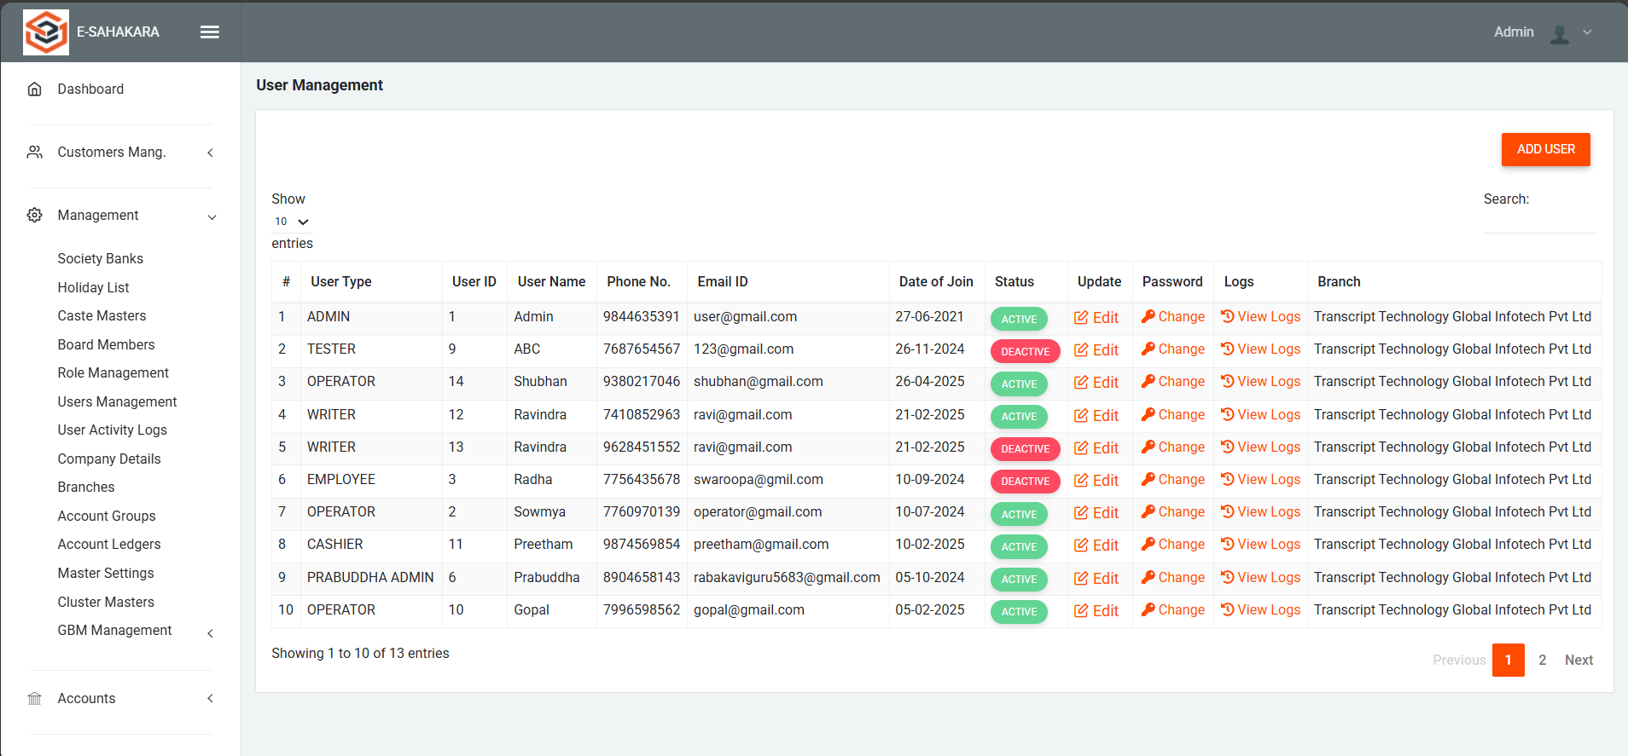
User Management

Slide 11
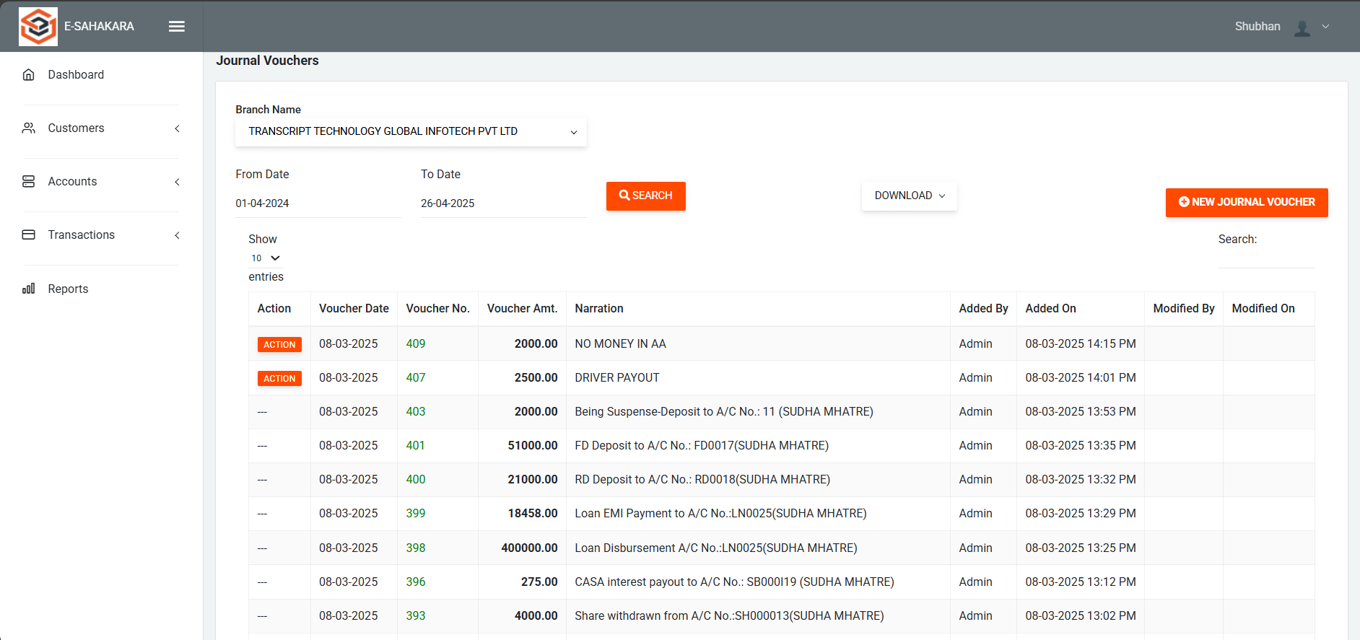
Journal Vouchers

Slide 12
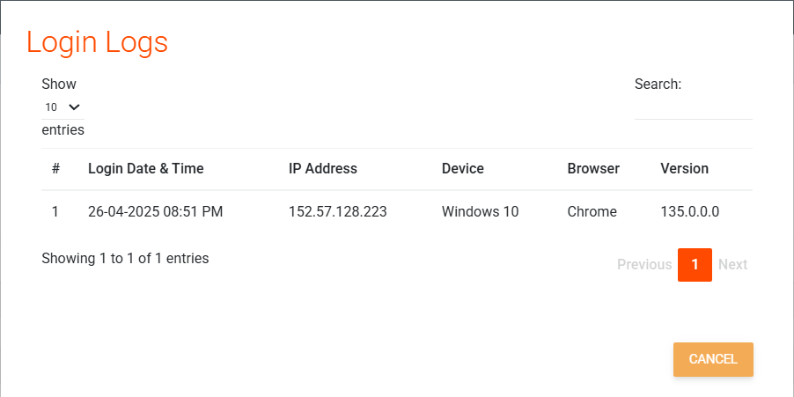
Login logs of user

Slide 13
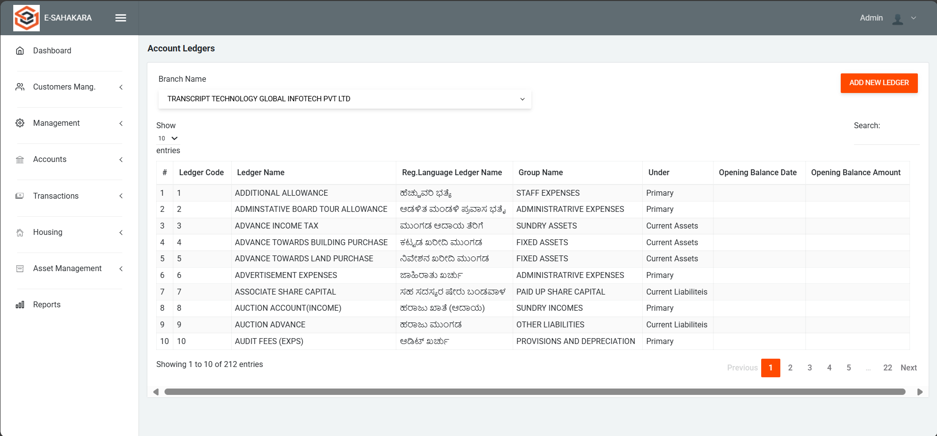
Account Ledgers

Slide 14
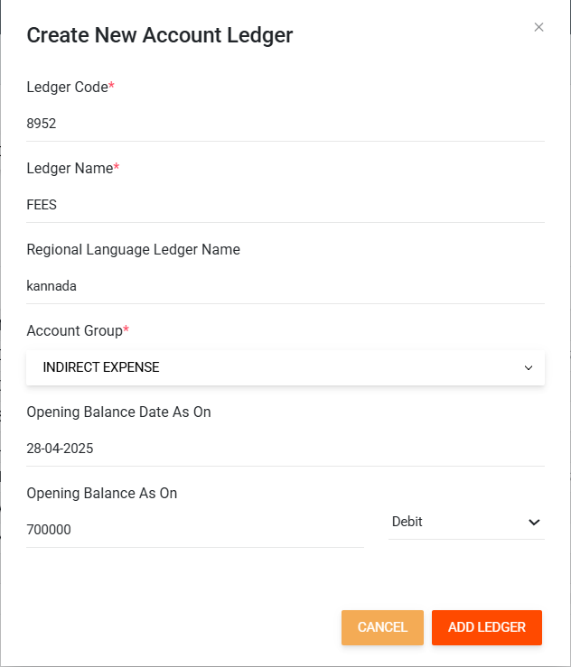
Create New Ledger

Slide 15
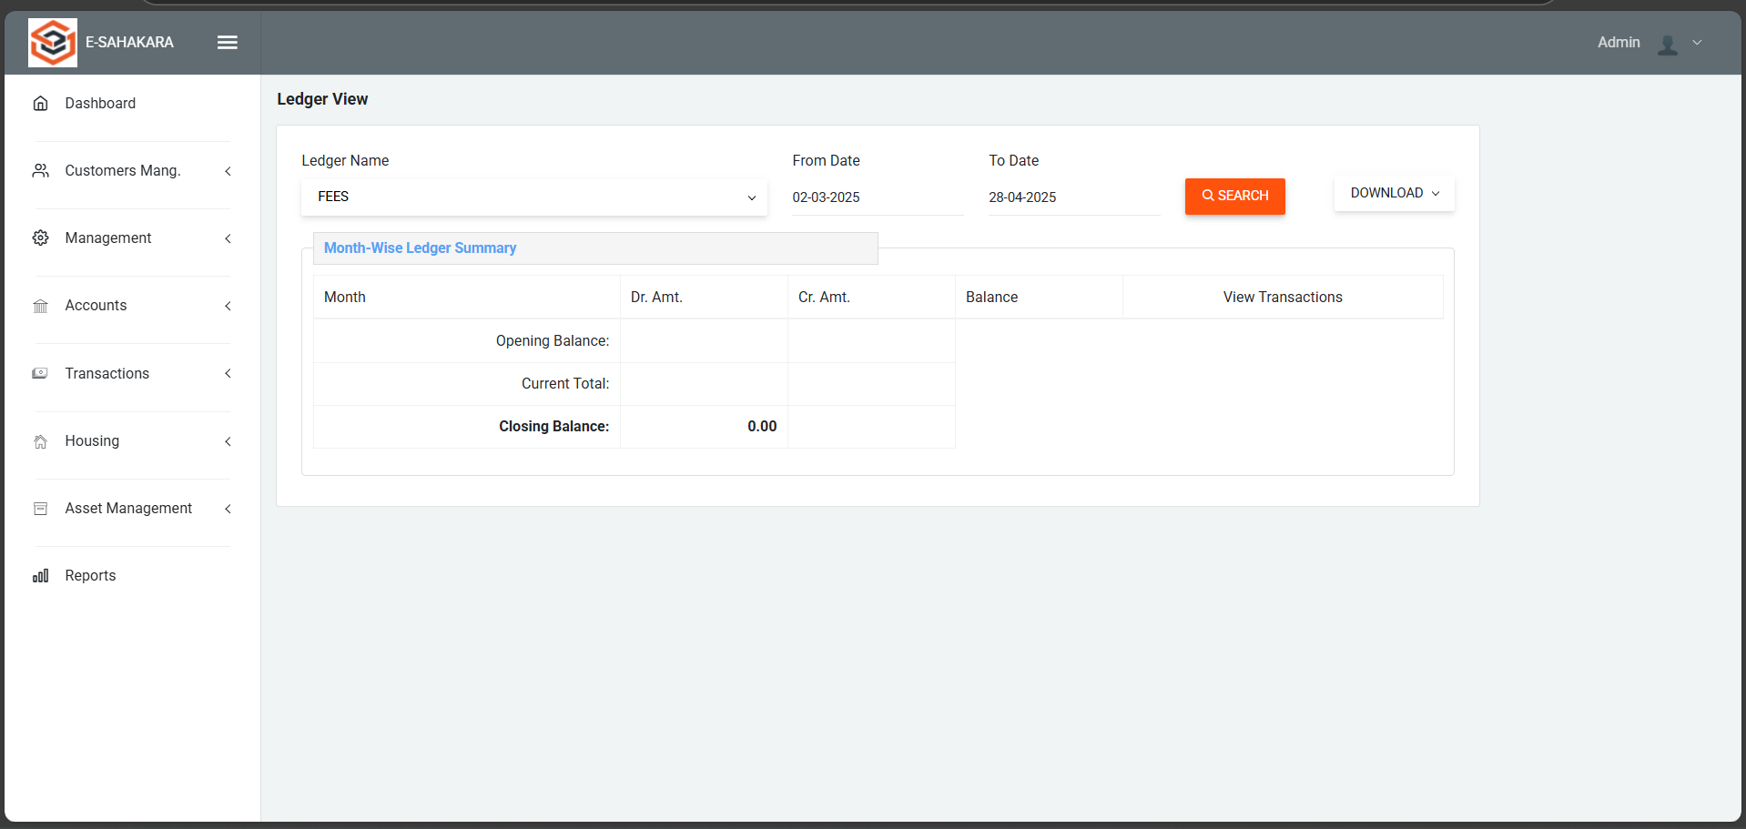
Ledger View

Slide 16
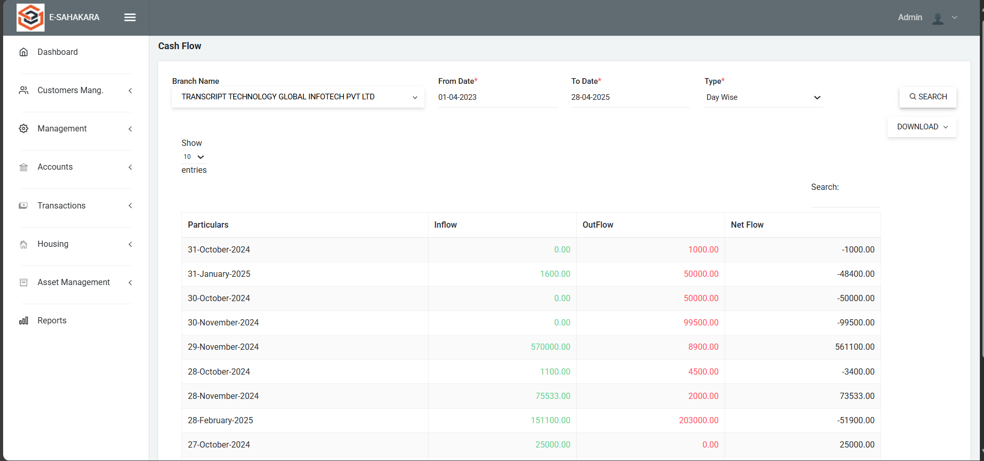
Cash Flow (Day wise)

Slide 17
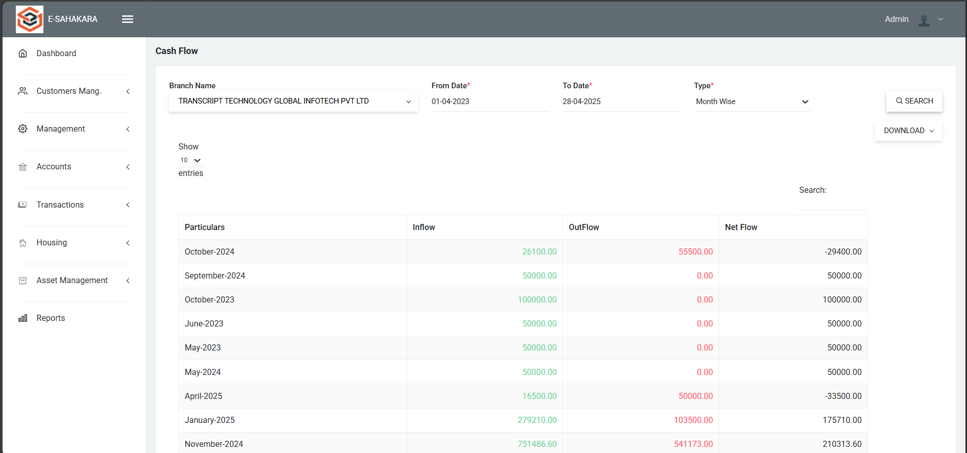
Cash Flow (Month wise)

Slide 18
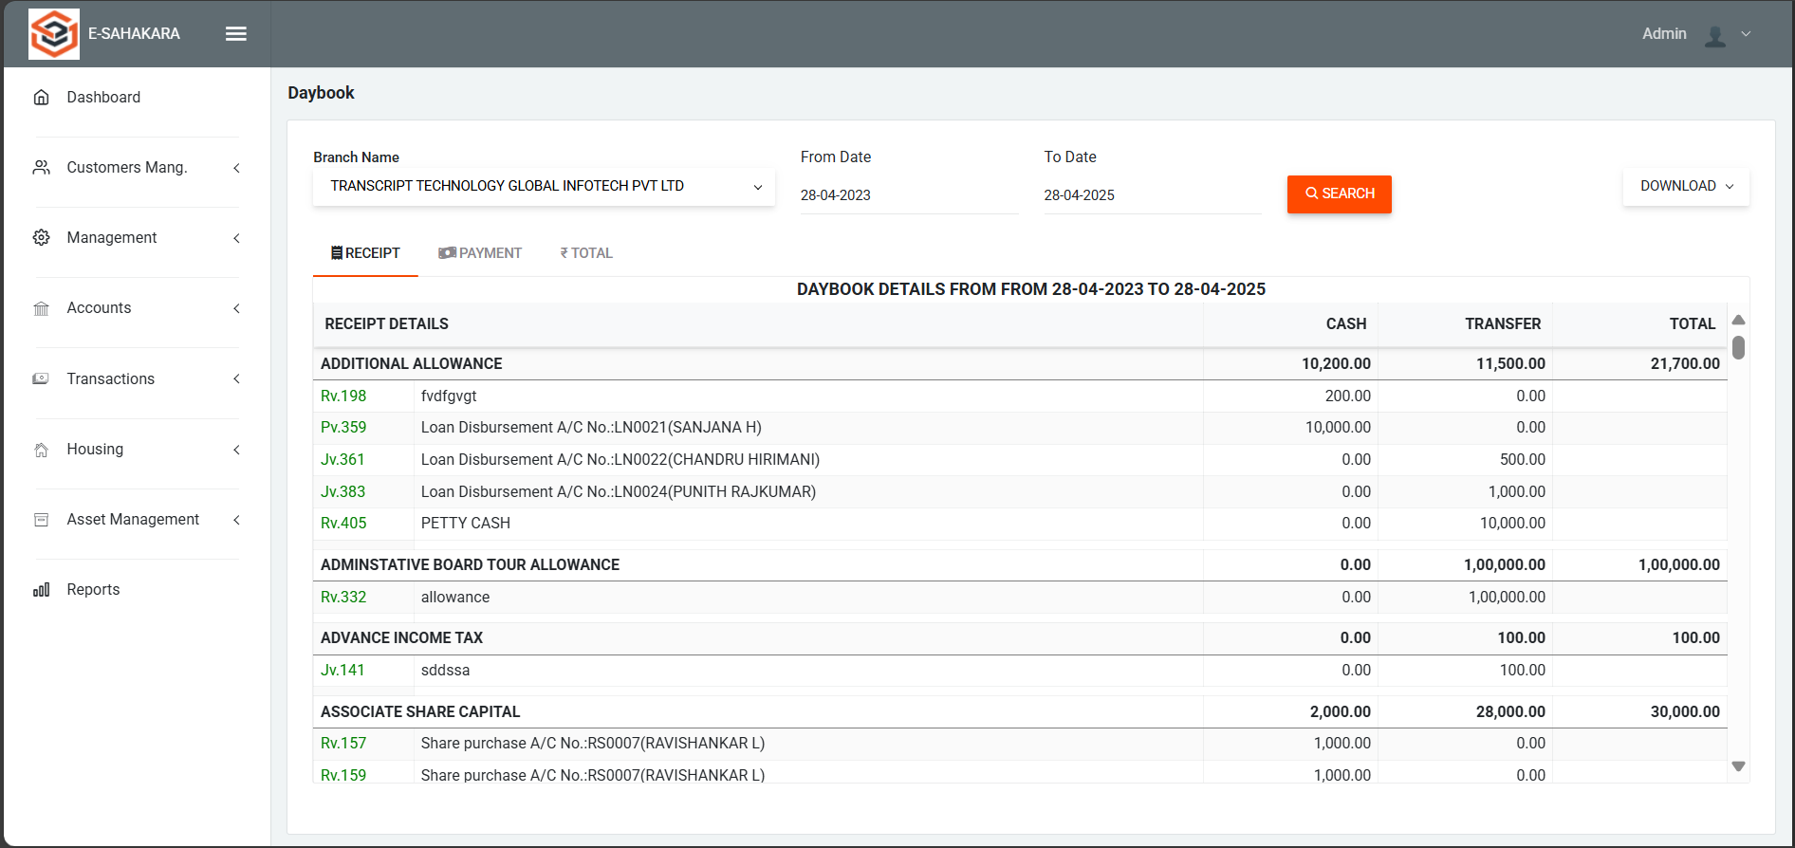
Daybook (Receipt)

Slide 19
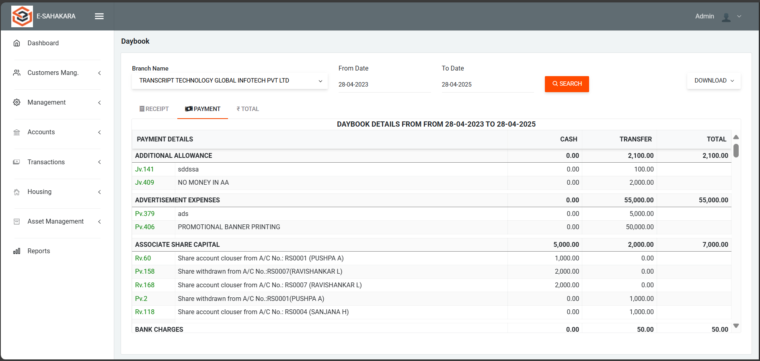
Daybook (Payment)

Slide 20
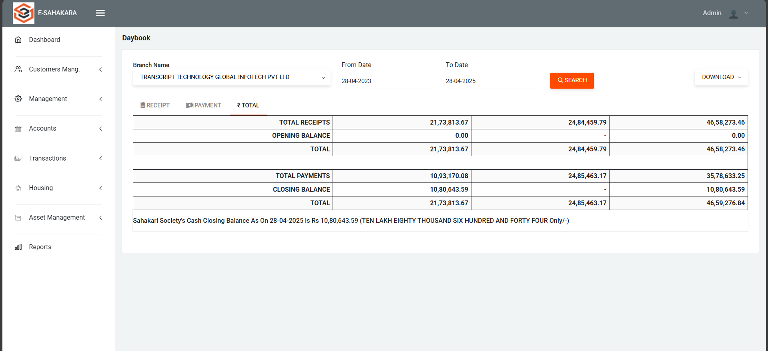
Daybook (Total)

Slide 21
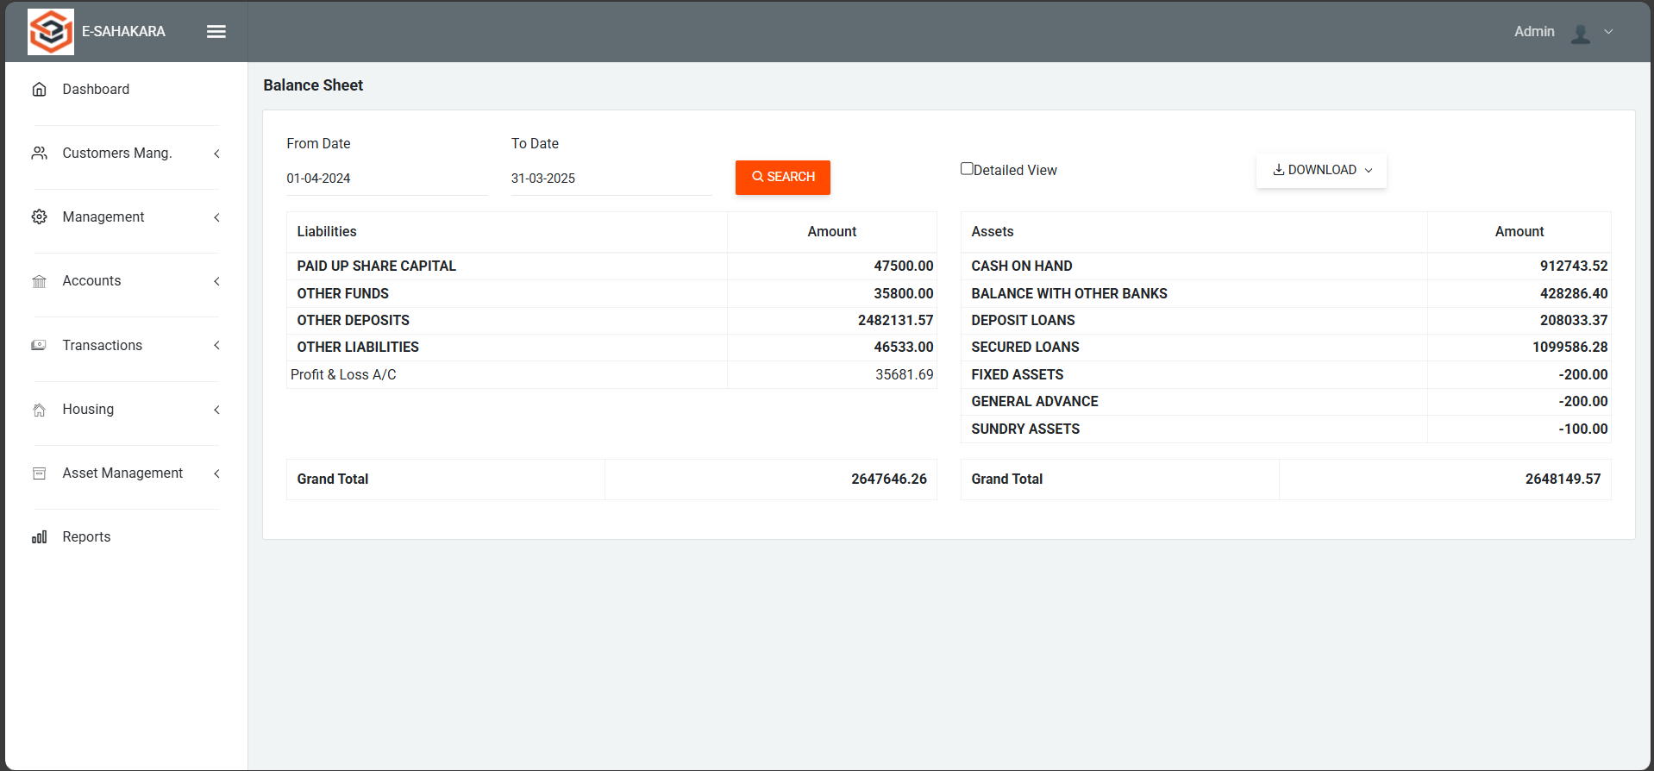
Balance Sheet

Slide 22
Github Link
GitHub Repository:
https://github.com/Shubhangc6/E-Sahakara

Slide 23


